Slide 1
RAD Curriculum Guide: Your roadmap for understanding RAD: Rental Assistance Demonstration
ORGANIZE
A. RESIDENT ORGANIZATIONS
B. ORGANIZING 101

Slide 2
RAD Curriculum Guide: Your roadmap for understanding RAD: Rental Assistance Demonstration
Organize:
Resident Organizations (ROs)
Types of Resident Groups
ROs in Details
Forming an RO

Slide 3
Organize: Resident Organizations (ROs)
INTRODUCTION
When organized, residents can:
Ensure their rights remain protected
Have more of a voice in the decision-making process
Provide input on the renovations that will take place
Create a transparent, trusting and productive working relationship with the new property manager

Slide 4
RAD Curriculum Guide: Your roadmap for understanding RAD: Rental Assistance Demonstration
TYPES OF RESIDENT GROUPS

Slide 5
Organize: Resident Organizations (ROs)
TYPES OF RESIDENT GROUPS
UNDER NYCHA
Resident Associations (RAs)

Slide 6
Organize: Resident Organizations (ROs)
TYPES OF RESIDENT GROUPS
UNDER NYCHA
Resident Associations (RAs)
District
Councils (DC)

Slide 7
Organize: Resident Organizations (ROs)
TYPES OF RESIDENT GROUPS
UNDER NYCHA
Citywide Council of Presidents (CCOP)
Resident Associations (RAs)
District
Councils (DC)

Slide 8
Organize: Resident Organizations (ROs)
TYPES OF RESIDENT GROUPS
UNDER NYCHA
Citywide Council of Presidents (CCOP)
Resident Associations (RAs)
District
Councils (DC)
Resident Advisory Board (RAB)

Slide 9
Organize: Resident Organizations (ROs)
TYPES OF RESIDENT GROUPS
UNDER RAD
Resident Associations (RAs)
Resident Organizations (ROs)
Notes:
The primary way for residents to directly and officially engage in decisions about their development is through their Resident Associations (RA). If an entire development converts to RAD, its RA will become a Resident Organization (RO).
Compared to RAs, ROs have the same rights to organize tenants and receive support from the property manager.

Slide 10
Organize: Resident Organizations (ROs)
TYPES OF RESIDENT GROUPS
UNDER RAD
Under RAD, there is no equivalent for DC, CCOP, or RAB
Resident Associations (RAs)
Resident Organizations (ROs)
Notes:
If you are not part of tenant leadership, that doesn’t mean you can’t influence what the other groups discuss. Getting involved in your development’s resident organization and voicing your concerns will help leadership prioritize the issues they discuss, and can help lift up common issues across developments.

Slide 11
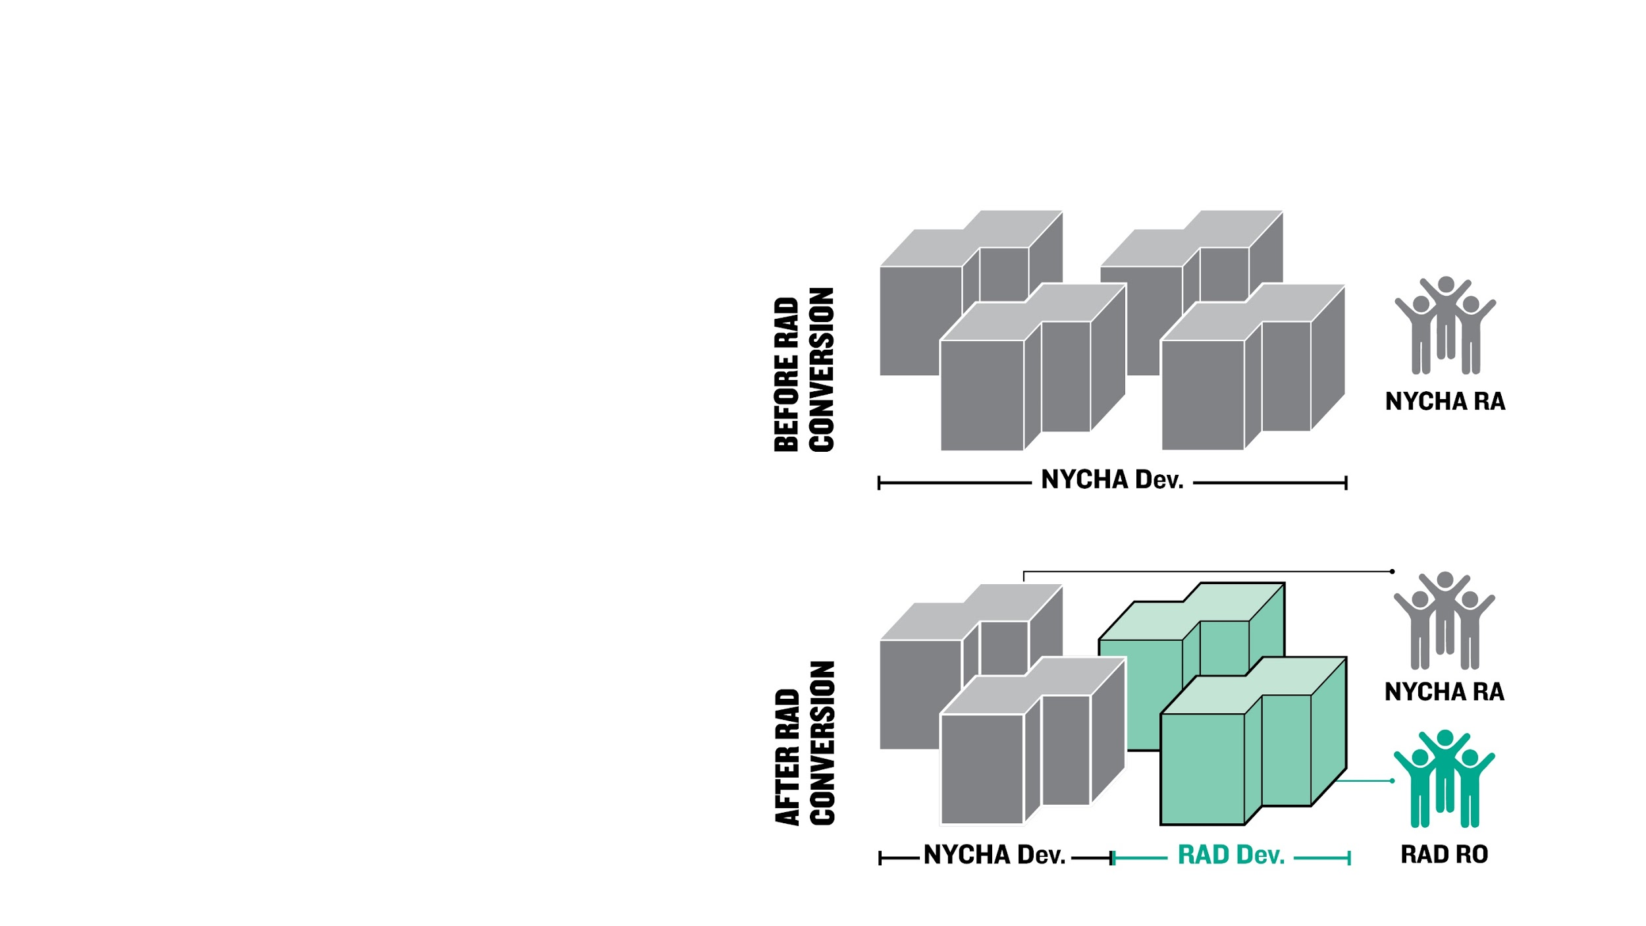
Organize: Resident Organizations (ROs)
TYPES OF RESIDENT GROUPS
UNDER RAD
If only part of your development is converting, you may need to form a new Resident Organization that represents only the RAD buildings.
Notes:
If only part of the development is converting, residents may need to form a new R0 that represents only the buildings converting to RAD.

Slide 12
RAD Curriculum Guide: Your roadmap for understanding RAD: Rental Assistance Demonstration
RESIDENT ORGANIZATIONS IN DETAIL

Slide 13
Organize: Resident Organizations (ROs)
RESIDENT ORGANIZATIONS IN DETAIL
A LEGITIMATE RO MUST:
Be established by the residents of the property;
Meet regularly;
Operate democratically;
Represent all residents at the property;
Be independent from the property owner
Notes:
ROs will continue to be funded at up to $25 per occupied unit per year
Up to $10 will go to the property manager, at least $15 goes towards resident participation
Activities and funds are to be used for resident education, organizing around tenancy issues, and training activities. The property manager should support any activity that falls into one of these buckets. Activities that fall outside of these buckets may not be eligible.

Slide 14
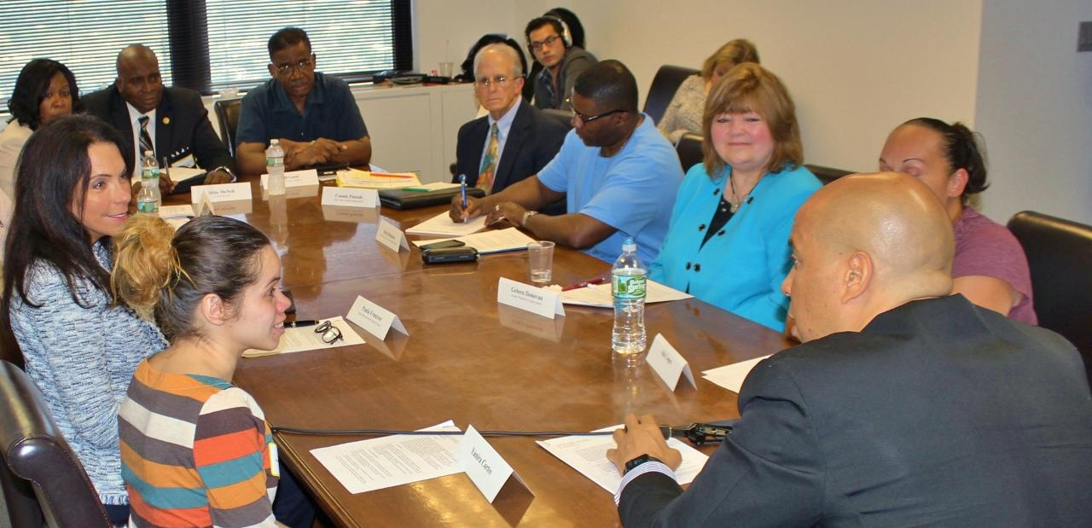
Organize: Resident Organizations (ROs)
RESIDENT ORGANIZATIONS IN DETAIL
Communication with the property manager will be most effective if done through the RO
Notes:
Organized tenants meet with Newark mayor Corey Booker
ROs can respond to:
Property owners’ requests for rent increases,
A partial payment of claims
Conversion from project paid utilities to tenant-paid utilities,
A reduction in tenant utility allowances,
Major capital additions, and
Loan prepayments

Slide 15
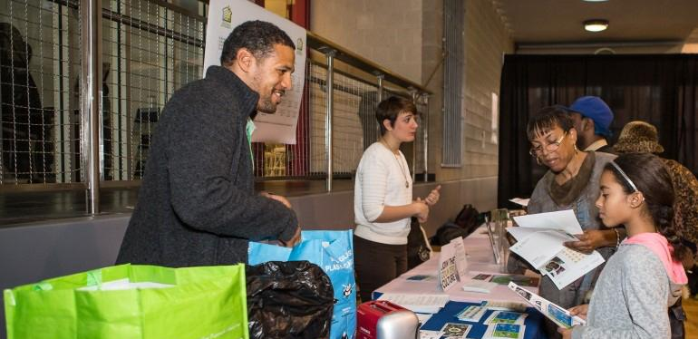
Organize: Resident Organizations (ROs)
RESIDENT ORGANIZATIONS IN DETAIL
Property managers must allow tenants to continue independent organized activities
Notes:
NYCHA Environmental Ambassadors
Property Managers must permit:
Distribution of leaflets in the lobby, other common areas, and under tenants’ doors
Posting of information on bulletin boards
Conducting door-to-door surveys to determine interest in establishing an RO or offer information about an existing RO
Assistance for tenants to participate in RO activities
Convening of RO meetings on-site in a manner that is fully independent of management representatives (Management representatives may not attend such meetings unless invited by the tenant organization)
Meeting in a location where residents can easily attend, including those with and disabilities
Conducting other reasonable activities

Slide 16
Organize: Resident Organizations (ROs)
RESIDENT ORGANIZATIONS IN DETAIL
ACTIVITIES THAT CANNOT BE FUNDED WITH TPA FUNDS:
Activities that do not directly offer services to improve resident quality of life. Ex: empowerment activities or social services resources;
Organized fundraising;
Giveaways to reward participation
Notes:
Additionally, the property manager must provide meeting space to accommodate RO activities if such a space is available.
An important item to note is that every RO has access to Tenant Participation Activity (TPA) funds. These funds are calculated at $25 per occupied unit per year and are to be used for the benefit of NYCHA residents and communities. Keep in mind that an RO will not necessarily receive the entire $25 per occupied apartment per year. The breakdown of funding is that up to $10 would go to the property manager while at least $15 would go to the RO. Funding cannot be used for activities that do not directly offer activities or services to improve resident quality of life.

Slide 17
RAD Curriculum Guide: Your roadmap for understanding RAD: Rental Assistance Demonstration
FORMING AN RO

Slide 18
Organize: Resident Organizations (ROs)
FORMING AN RO
BEST PRACTICES - GETTING STARTED:
Talk to neighbors to understand common issues
Gauge interest in getting involved
Find a core group to help you organize

Slide 19
Organize: Resident Organizations (ROs)
FORMING AN RO
BEST PRACTICES – SET A MEETING:
Meet with the core group to organize a building-wide meeting
Agree on goals for the meeting: for ex, addressing a widespread issue
Get the word out to as many people as possible

Slide 20
Organize: Resident Organizations (ROs)
FORMING AN RO
BEST PRACTICES – PRODUCTIVE MEETINGS:
Stick to your agenda but leave room for the group to add other priorities
Start and end on time
End with actionable next steps
Set the next meeting so people know when to follow up on next steps

Slide 21
Organize: Resident Organizations (ROs)
FORMING AN RO
BEST PRACTICES – FORMALIZE:
Formalize resident leadership by developing election protocol
Create by-laws so everyone understands the decision-making practice for the RO

Slide 22
Organize: Resident Organizations (ROs)
KEY TAKEAWAYS
KEY TAKEAWAYS
Tenant leadership has one of the most important roles to play in the conversion processes – getting residents informed about the changes to come and getting them engaged.
Basic organizing tools can help maximize participation and ensure a productive working relationship with NYCHA
Notes:
Resident Organizations should take a leadership role in understanding RAD, using resources like this curriculum to teach residents about RAD and what they can expect, making sure any myths are properly addressed, asking questions, and meeting with NYCHA and the development team regularly to make sure resident needs are heard.

Slide 23
RAD Curriculum Guide: Your roadmap for understanding RAD: Rental Assistance Demonstration
Organize: Organizing 101
Case Study Title
Identifying Community Needs
Creating a Call to Action

Slide 24
Organize: Resident Organizations (ROs)
INTRODUCTION
When organized, ROs can:
Attend meetings on RAD to keep the resident population informed and ask questions on their behalf.
Help ensure that residents’ leases are up to date before the property converts to RAD.
Make sure the Physical Needs Assessment accurately reflects the needs of the building.
Advocate for accommodations to keep residents comfortable and healthy during the construction process.

Slide 25
RAD Curriculum Guide: Your roadmap for understanding RAD: Rental Assistance Demonstration
CASE STUDY:
NYC RAD Roundtable on Resident Rights and Protections

Slide 26
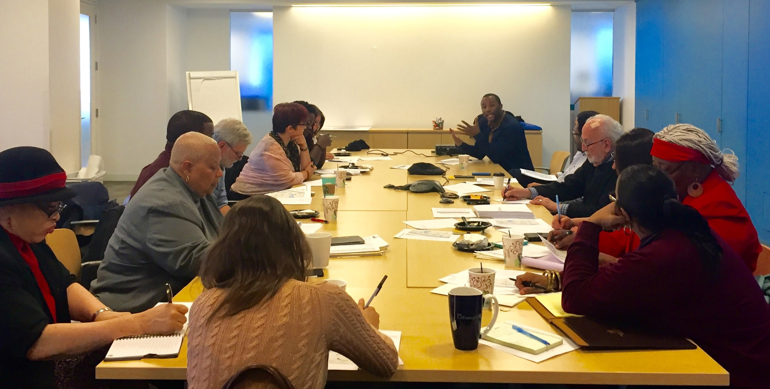
Organize: Organizing 101
CASE STUDY TITLE
Notes:
Goals of the RAD Roundtable:
Creating the RAD “Guiding Principles”;
Providing ongoing education and information sharing on the RAD program in NYC;
Identifying and addressing gaps in resident rights and protections under RAD;
Acting as a feedback loop for resident voices to be heard and incorporated into NYCHA’s program implementation and policies;
Providing independent forums to assure that residents are informed of their options, rights, and protections as they engage with NYCHA and other key actors in the conversion process.

Slide 27
RAD Curriculum Guide: Your roadmap for understanding RAD: Rental Assistance Demonstration
IDENTIFYING COMMUNITY NEEDS

Slide 28
Organize: Resident Organizations (ROs)
IDENTIFYING COMMUNITY NEEDS
COMMUNITY NEEDS ASSESSMENT:
PRACTICE INTERVIEW
Instructions: Work in pairs to practice interviewing each other about the needs in your community. Use the Community Needs Assessment handout to guide the conversation. Write down 1-2 priorities you learn from your partner that you will report back on.

Slide 29
RAD Curriculum Guide: Your roadmap for understanding RAD: Rental Assistance Demonstration
CREATING A CALL TO ACTION

Slide 30
Organize: Resident Organizations (ROs)
CREATING A CALL TO ACTION
ORGANIZING SCENARIOS
Instructions: Work in small groups to develop an organizing strategy to address the scenario provided. Write a brief Action Plan (5-10 bullet points) that you will report back on. Keep in mind:
What are you trying to achieve? What is your mission?
What are the potential obstacles?
What will get others interested in your cause?
Who can you contact for support?

Slide 31
Organize: Resident Organizations (ROs)
CREATING A CALL TO ACTION
ORGANIZING SCENARIOS: POWER MAP
Who has a stake in the issue? Who has decision-making power?

Slide 32
THANK YOU FOR PARTICIPATING!

