Slide 1
RAD Curriculum Guide: Your roadmap for understanding RAD: Rental Assistance Demonstration
PREPARE FOR RAD
A. KNOW YOUR RIGHTS
B. GET INVOLVED

Slide 2
RAD Curriculum Guide: Your roadmap for understanding RAD: Rental Assistance Demonstration
Prepare for RAD:
Know Your Rights
Common Concerns
Rights with Responsibilities
NYC Specific Rights

Slide 3
RAD Curriculum Guide: Your roadmap for understanding RAD: Rental Assistance Demonstration
COMMON CONCERNS

Slide 4
Prepare for RAD: Know Your Rights
COMMON CONCERNS

Slide 5
Prepare for RAD: Know Your Rights
COMMON CONCERNS
NYCHA will not sell land or buildings through RAD
NYCHA will be a partial owner in a private-public partnership
Rent will be set at 30% of income

Slide 6
Prepare for RAD: Know Your Rights
COMMON CONCERNS

Slide 7
Prepare for RAD: Know Your Rights
COMMON CONCERNS
Existing residents will not be displaced, and will have the right to remain without rescreening
Under RAD, residents maintain all the same basic rights such as succession, affordability and the right to organize

Slide 8
RAD Curriculum Guide: Your roadmap for understanding RAD: Rental Assistance Demonstration
RIGHTS WITH RESPONSIBILITIES

Slide 9
Prepare for RAD: Know Your Rights
RIGHTS WITH RESPONSIBILITIES
1. Residents have the right to remain.

Slide 10
Prepare for RAD: Know Your Rights
RIGHTS WITH RESPONSIBILITIES
1. Residents have the right to remain.
RESPONSIBILITY: Check with NYCHA to make sure their current lease includes all household members, and register any pets and major appliances

Slide 11
Prepare for RAD: Know Your Rights
RIGHTS WITH RESPONSIBILITIES
2. Residents will receive new 12-month leases that the new property owner must renew every year.

Slide 12
Prepare for RAD: Know Your Rights
RIGHTS WITH RESPONSIBILITIES
2. Residents will receive new 12-month leases that the new property owner must renew every year.
RESPONSIBILITY: Make sure any benefits that go towards rent are directed to new property manager
Notes:
Additional responsibilities
Read lease carefully
Seek assistance in understanding the terms of their lease if needed

Slide 13
Prepare for RAD: Know Your Rights
RIGHTS WITH RESPONSIBILITIES
3. Rent will continue to be set at 30% of income, and residents will not need to pay a new security deposit.

Slide 14
Prepare for RAD: Know Your Rights
RIGHTS WITH RESPONSIBILITIES
3. Rent will continue to be set at 30% of income, and residents will not need to pay a new security deposit.
RESPONSIBILITY: Pay rent to new property manager instead of NYCHA. Continue to recertify annually with NYCHA and potentially also with the new property manager

Slide 15
Prepare for RAD: Know Your Rights
RIGHTS WITH RESPONSIBILITIES
4. Tenant Associations are called Resident Organizations (RO) under RAD. ROs will continue to be funded at up to $25 per unit.

Slide 16
Prepare for RAD: Know Your Rights
RIGHTS WITH RESPONSIBILITIES
4. Tenant Associations are called Resident Organizations (RO) under RAD. ROs will continue to be funded at up to $25 per unit.
RESPONSIBILITY: Get involved in your resident association, and form a resident organization if one does not exist
Notes:
Additional responsibilities
If only a portion of your development is being converted, talk to NYCHA to understand whether you need to form a new Resident Organization.

Slide 17
RAD Curriculum Guide: Your roadmap for understanding RAD: Rental Assistance Demonstration
NYC SPECIFIC RIGHTS

Slide 18
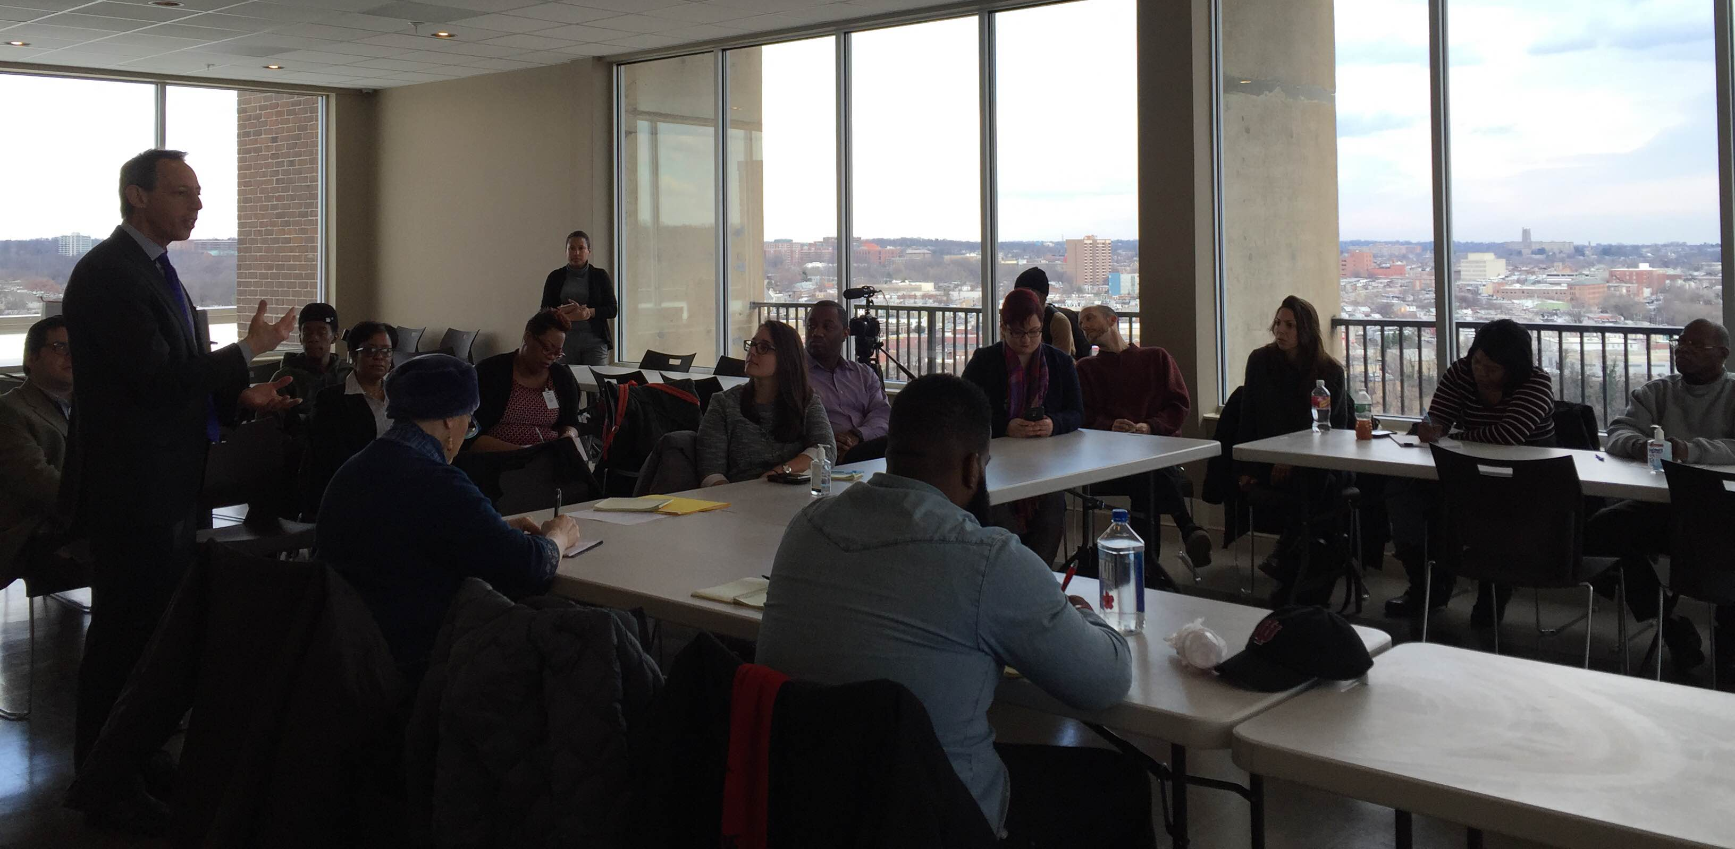
Prepare for RAD: Know Your Rights
NYC SPECIFIC RIGHTS
NYC RAD Roundtable on Resident Rights and Protections
Notes:
RAD Guiding Principles were developed by the NYC RAD Roundtable on Resident Rights and Protections (RAD Roundtable): a group of resident leaders and advocates.
The goal of the Roundtable was to identify gaps in the federal regulations and recommend NYC-specific provisions to further protect and advocate for residents.
RAD Guiding Principles have been accepted as a standard by NYCHA and are embedded in the contract with the new owner/manager.
The guiding principles secure key resident rights by clarifying what is expected of NYCHA and the development team throughout the conversion process.

Slide 19
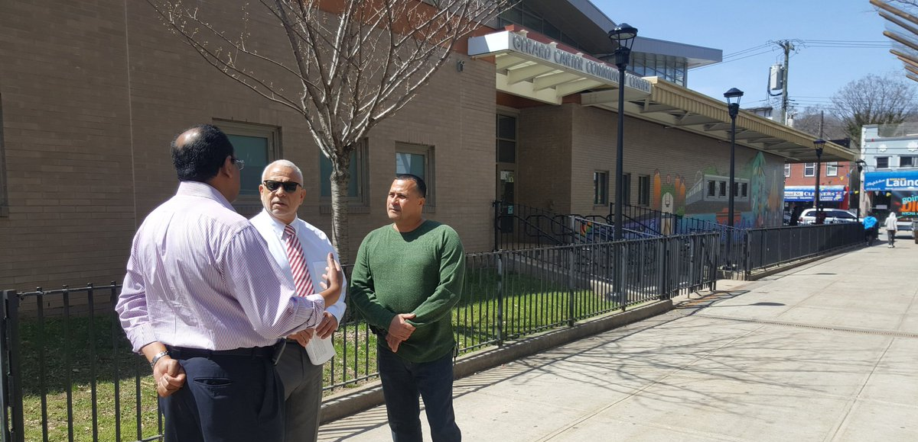
Prepare for RAD: Know Your Rights
NYC SPECIFIC RIGHTS
Guiding Principles help property managers operate in a way that will uphold resident rights
Notes:
Role of guiding principles for property managers: Outline requirements for resident engagement and training/hiring opportunities, both during construction and in permanent positions.

Slide 20
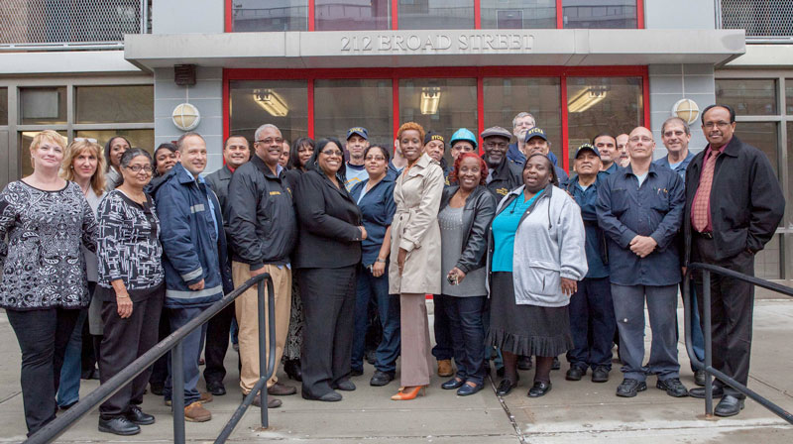
Prepare for RAD: Know Your Rights
NYC SPECIFIC RIGHTS
Guiding Principles establish a role for NYCHA with ongoing oversight
Notes:
Role of guiding principles for NYCHA: Outline requirements for resident engagement and establish a role for ongoing oversight.

Slide 21
Prepare for RAD: Know Your Rights
NYC SPECIFIC RIGHTS
Enhanced rights & protections:
Resident Education
Notes:
The RAD Guiding Principles protect and enhance resident rights in NYC beyond federal requirements.
Here are a few examples:
1. Resident Education: A RAD handbook shall be distributed to all affected residents, providing comprehensive information about RAD conversion, including how RAD will differ from public housing and the potential impacts for residents and the community.

Slide 22
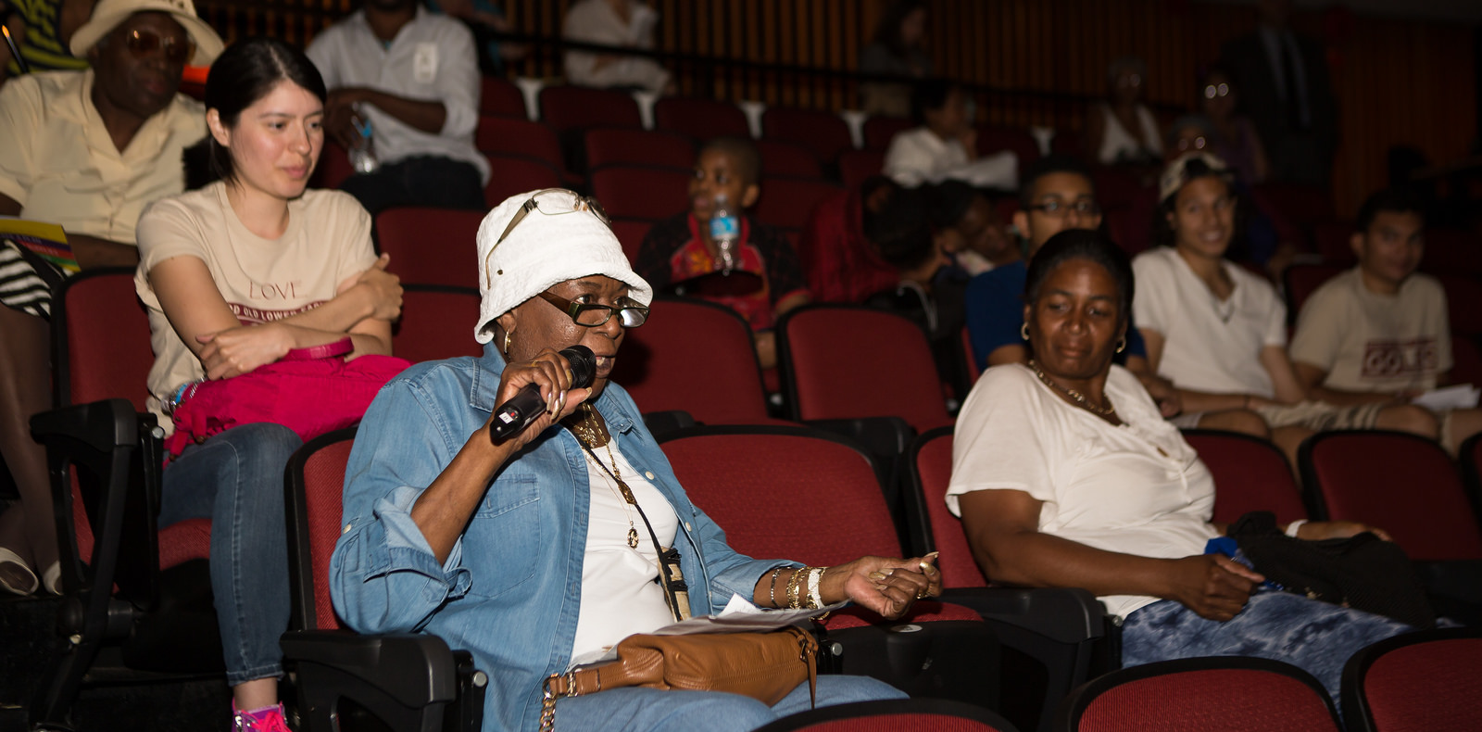
Prepare for RAD: Know Your Rights
NYC SPECIFIC RIGHTS
Enhanced rights & protections:
Communication among ROs
& protections regarding temporary relocation
Notes:
2. Communications Among ROs: In order to promote communication among ROs once a number of RAD conversions take place, NYCHA will provide ROs with contact information for other RAD property managers to enable organizations to communicate.
3. Temporary Relocation: If any relocation is necessary, NYCHA and the PM must provide residents with the written relocation plans and inform them of their right to return and protections from relocation costs.

Slide 23
RAD Curriculum Guide: Your roadmap for understanding RAD: Rental Assistance Demonstration
Prepare for RAD:
Get Involved
Engagement
Key Resident Issues

Slide 24
RAD Curriculum Guide: Your roadmap for understanding RAD: Rental Assistance Demonstration
ENGAGEMENT

Slide 25
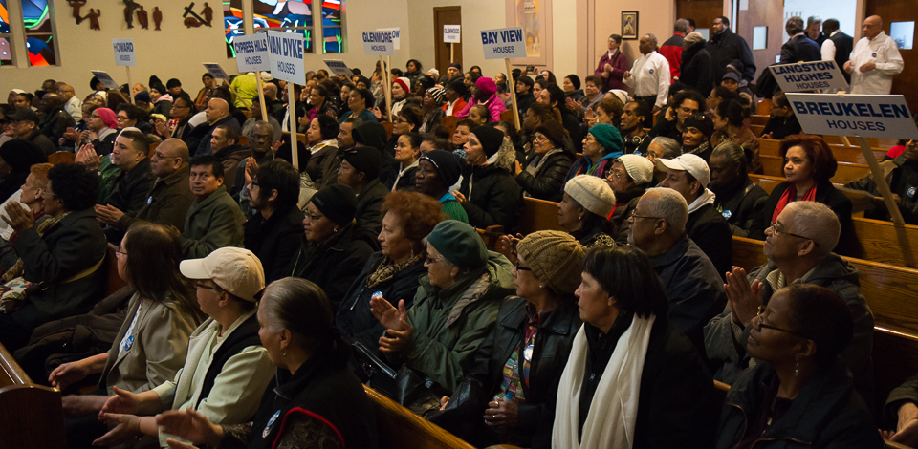
Prepare for RAD: Get Involved
ENGAGEMENT
RESIDENT ENGAGEMENT PHASE 1
Notes:
Preliminary meetings – residents should:
Learn what RAD means for their development
Ask questions and organize
Get involved with their resident organization or start one if one does not yet exist

Slide 26
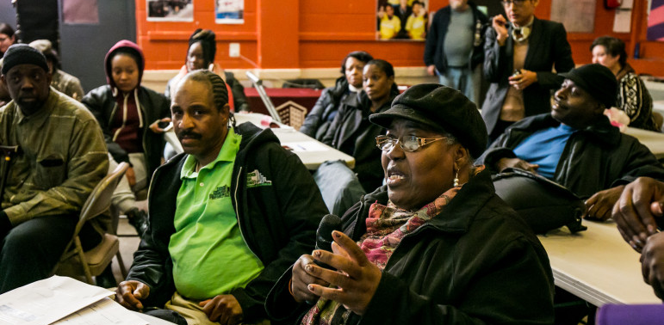
Prepare for RAD: Get Involved
ENGAGEMENT
RESIDENT ENGAGEMENT PHASE 2: 1-2 years
Notes:
Property assessment, ongoing meetings, and lease up – residents should:
Help identify repairs to be included in the final scope of work
Identify social services they want offered
Make sure all household members are on the lease
Learn about training and job opportunities
Find out if temporary relocations are needed

Slide 27
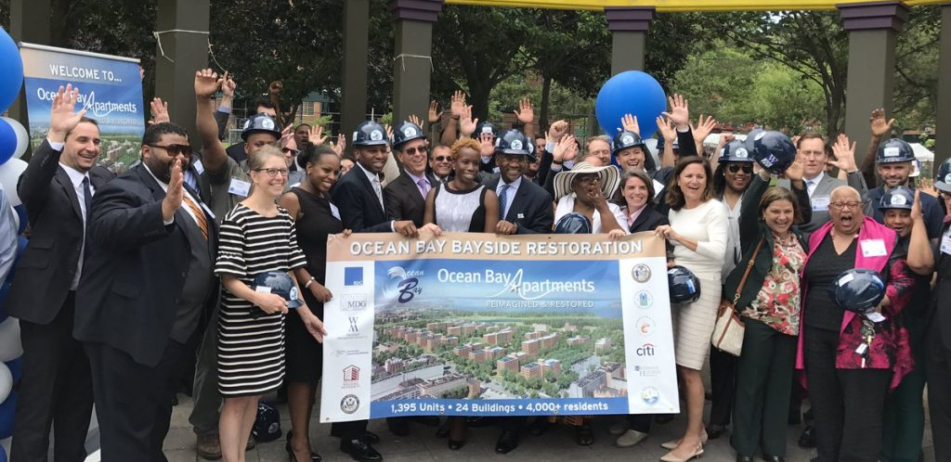
Prepare for RAD: Get Involved
ENGAGEMENT
RENOVATION:
2 years or less
Notes:
Renovation – residents should:
Look out for construction updates that affect their apartments directly and might disturb access to heat or hot water
Be prepared for some interruptions to daily life – noise, dust, construction debris etc.
Request reasonable accommodation if they are worried construction will affect any existing health conditions

Slide 28
RAD Curriculum Guide: Your roadmap for understanding RAD: Rental Assistance Demonstration
KEY RESIDENT ISSUES

Slide 29
Prepare for RAD: Get Involved
KEY RESIDENT ISSUES
SECTION 8 SUBSIDY & NEW LEASES
The RAD conversion will end your public housing lease, and you will have a Section 8 subsidy agreement with NYCHA.
Residents will receive new 12-month Section 8 leases that the new property owner is required to renew every year.

Slide 30
Prepare for RAD: Get Involved
KEY RESIDENT ISSUES
PHYSICAL NEEDS ASSESSMENT
Once a development team is selected to renovate and manage the property, they will conduct a property assessment to determine what repairs will be done.
From this, the development team will draw up a Final Scope of Work that details work to be done.

Slide 31
Prepare for RAD: Get Involved
KEY RESIDENT ISSUES
TEMPORARY RELOCATION
NYCHA’s goal is for all RAD properties to be renovated with tenants in place, and minimize the impact of construction on daily life. However, in some cases, due to the extent of the renovation, temporary relocation may be necessary for health and safety reasons.

Slide 32
Prepare for RAD: Get Involved
KEY RESIDENT ISSUES
TRANSFERS AND CHOICE MOBILITY
After X date, residents at properties converting to RAD will no longer be able transfer to other NYCHA developments. 1 year after conversion, residents can apply for a Housing Choice Voucher to move elsewhere.

Slide 33
Prepare for RAD: Get Involved
KEY RESIDENT ISSUES
GRIEVANCES
After RAD conversion, depending on the issue at hand, some grievances will be processed by the new owner/manager and some by NYCHA.

Slide 34
Prepare for RAD: Get Involved
KEY RESIDENT ISSUES
TERMINATION OF SECTION 8 SUBSIDY
If your Section 8 rental assistance is terminated by NYCHA, the new owner/manager will no longer receive rental assistance for your apartment. You may therefore be at risk of eviction.

Slide 35
While key resident rights will remain protected under RAD, residents should stay engaged throughout conversion to ensure a smooth process. Be on the look out for opportunities to meet with the development team to voice questions and concerns.
NEXT UP: ORGANIZE

