Slide 1
Southeast Rural Housing Preservation Academy
Notes:
Welcome again to the Southeast Rural Housing Preservation Academy. Today we will cover Capital Needs Assessment. What it is, whats the process, and the purpose of acquiring a CNA. I’m Adrienne Norwood, Senior Program Associate for our Mountain, Rural and Tribal team. Before we start, I would like to go over a couple of house keeping notes.

Slide 2
Housekeeping
All registered attendees will receive the slides via email
This session is being recorded. You will receive a copy and it will be posted on the Enterprise website
We will answer questions throughout the presentation. Please submit them using the Q&A or chat or raise hand function
Please tell us how we did in the survey at the end of the session
Notes:
Please keep in mind that all registered attendees will receive the PPT and recording in the following days. We will answer questions throughout the presentation. Please submit any questions using the Q&A, and chat function or raise your hand. We would also like for you to fill out our survey at the end of the presentation.

Slide 3
Land Acknowledgment
Notes:
And now we will have a land acknowledgement from Vice President of Mountain, Tribal Nations and Rural Communities Markets, Jennie Rogers

Slide 4
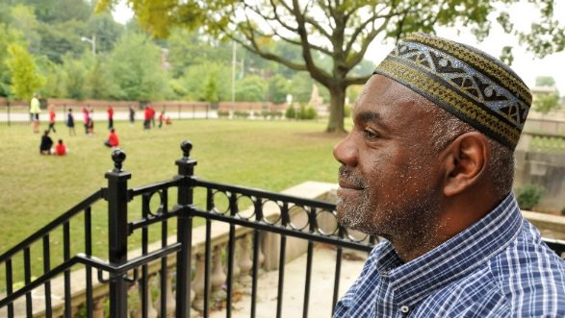
WHO WE ARE AND WHAT WE DO
We develop and deploy programs and support community organizations on the ground
We advocate for policy on a nonpartisan basis at every level of government​
We invest capital to build and preserve rental homes people can afford
We own and operate 13,000 affordable homes and provide resident services for 23,000 people
Notes:
As we work to address America’s affordable housing crisis from every angle, Enterprise is tackling barriers head on with programmatic solutions, policy advocacy and capital investment, and by listening to our residents who live in the 13,000 affordable homes we own and operate, where we provide resident services for 22,000 people. And we do it all in partnership with communities and entities who share our drive to make a difference for families and communities.

Slide 5
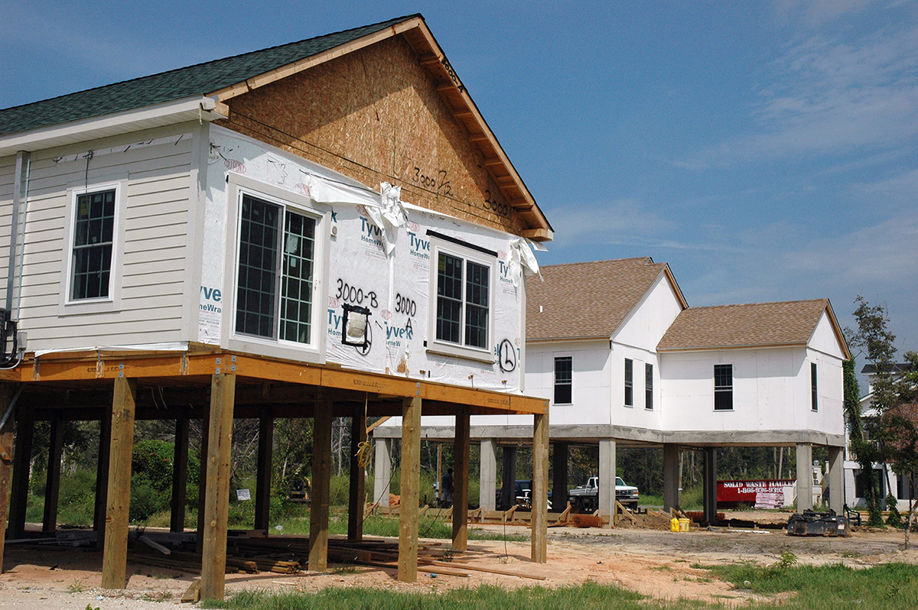
OUR VISION​ A country where home and community ​are steppingstones to more. ​ ​ OUR MISSION​ To make home and community places of pride, power and belonging, and platforms for resilience and upward mobility for all.
Notes:
We at Enterprise believe that a country is where home and community are steppingstones to much more. And our mission is to make home and community a place of pride, power and belonging and platforms for resilience and upward mobility for all. One of our three strategic pillars of work is to increase affordable housing supply and preservation is key to making that a reality.

Slide 6
SOUTHEAST RURAL PRESERVATION ACADEMY
Overview and Introduction to Rural Rental Housing Preservation
Rural Rental Housing Preservation in the Southeast
Overview of USDA Rural Development Housing and the 515 Transfer Process
Strategies for Preservation: Case Studies
Basic Deal Structuring
Pro-forma development
Funding the gaps: private debt, Section 538 and alternative sources/Beyond RD
Capital Needs Assessment, Architects and Scope of Work
Cohort breakout: offers a deeper dive into 515
Property Management/Community Engagement–2 sessions, including
Property Management, Disaster Preparedness & Mitigation
Community and Resident Engagement
State and Local Policy Solutions
Notes:
So far in our sessions, we’ve covered

Slide 7
Our Partners
Notes:
Many thanks to our partners Truist, Fannie Mae and Georgia Power for their commitment to this work as a shared priority.

Slide 8
Jim Howell for Gibson consulting, LLC
Notes:
So now, I will introduce our fist presenter Jim Howell. Jim is the Senior Analyst for GIBCO, Environmental, LLC and also serves as the Senior Market Analyst, Environmental Professional and Senior Report Writer for Gibson Consulting, LLC and GIBCO. Since 1995 Mr. Howell has performed numerous cost and operating audits for multi-family units as well as provided consultation to clients in the field of construction and property management. This evolved into providing market studies, CNAs and Environmental Studies for LIHTC, USDA and HUD financing applications.

Slide 9
Capital Needs Assessment
Jim Howell
GIBCO Environmental, LLC
Jim@fgibsonconsulting.com

Slide 10
What does THE cna affect?
RENTS
RESERVES
REHAB
CASH FLOW
ACCESSIBILITY

Slide 11
RENTS, RESERVES & CASH FLOWS ARE IMPACTED BY EACH OTHER AND REHAB ACCESSIBILITY AFFECTS REHAB BUDGET

Slide 12
OWNER FUNDED IMPROVEMENTS

Slide 13
QUALITY OF REHABILITATION and IMPROVEMENTS

Slide 14
Questions?

Slide 15
Marty miller Office of rural and farmworker housing
Notes:
Marty Miller has served as the Executive Director of the Office of Rural and Farmworker Housing (ORFH) since 2004. Prior to that, Marty was the Director of Housing Development and started as a Housing Developer at ORFH. Marty serves on a number of regional and national boards and committees, including the National Rural Housing Coalition and Rural Community Assistance Corporation, engaging in policy work at all levels to improve affordable housing in rural WA.

Slide 16
Capital Needs Assessment (C.N.A.), Architects & Scope of Work
SE Rural Rental Housing Preservation Academy
Marty Miller
Office of Rural and Farmworker Housing
Yakima, WA

Slide 17
Capital Needs Assessment
What is a Capital Needs Assessment or C.N.A.
Accessibility and the 504 Transition Plan
Selecting a C.N.A. Provider

Slide 18
Capital Needs Assessment
C.N.A. Provider
Project Architect
or

Slide 19
Contract: USDA Unnumbered Letter (UL)
Dated November 27, 2017
Statement of Work, Rehab, Other
Owner's Intent

Slide 20
Overview of Process:
Statement of Work
Preparation
Site Visit
The Report
Other
Scope of Work with Project Architect

Slide 21
Preparation: 48-hour notice
Age of work completed at the property
Availability of Plans

Slide 22
The Site Visit
Include USDA RD Rep
Include Project Architect if possible
Ladder,
Flashlight, etc.

Slide 23
Other
Lead
Asbestos
Plumbing
Methamphetamine

Slide 24
The Report
Project Architect
Review of C.N.A.
Health, Safety and Accessibility
Prepare Scope of Work for Rehabilitation

Slide 25
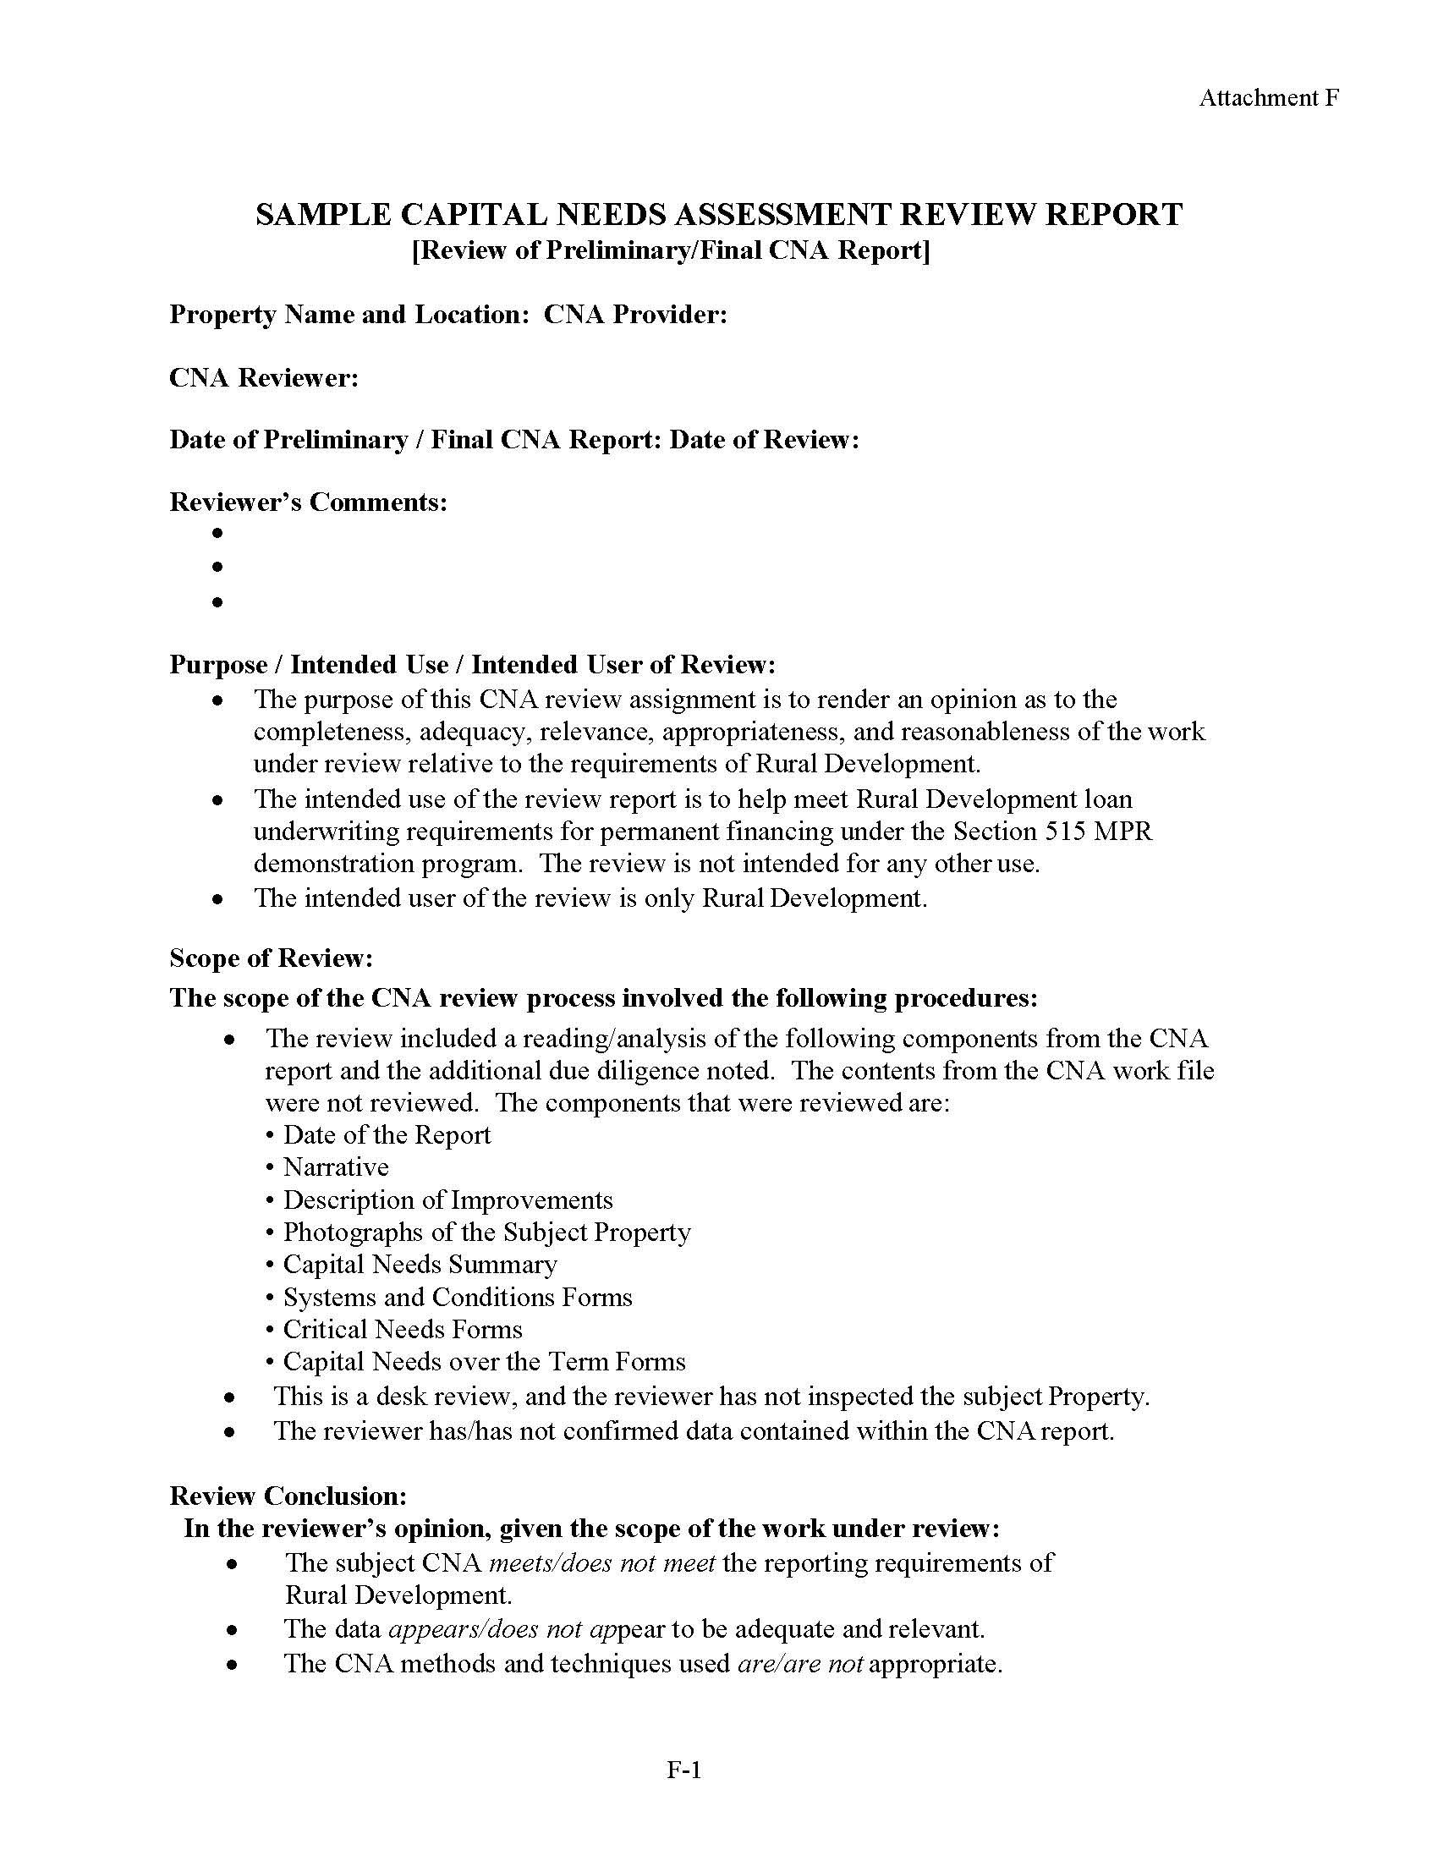

Slide 26
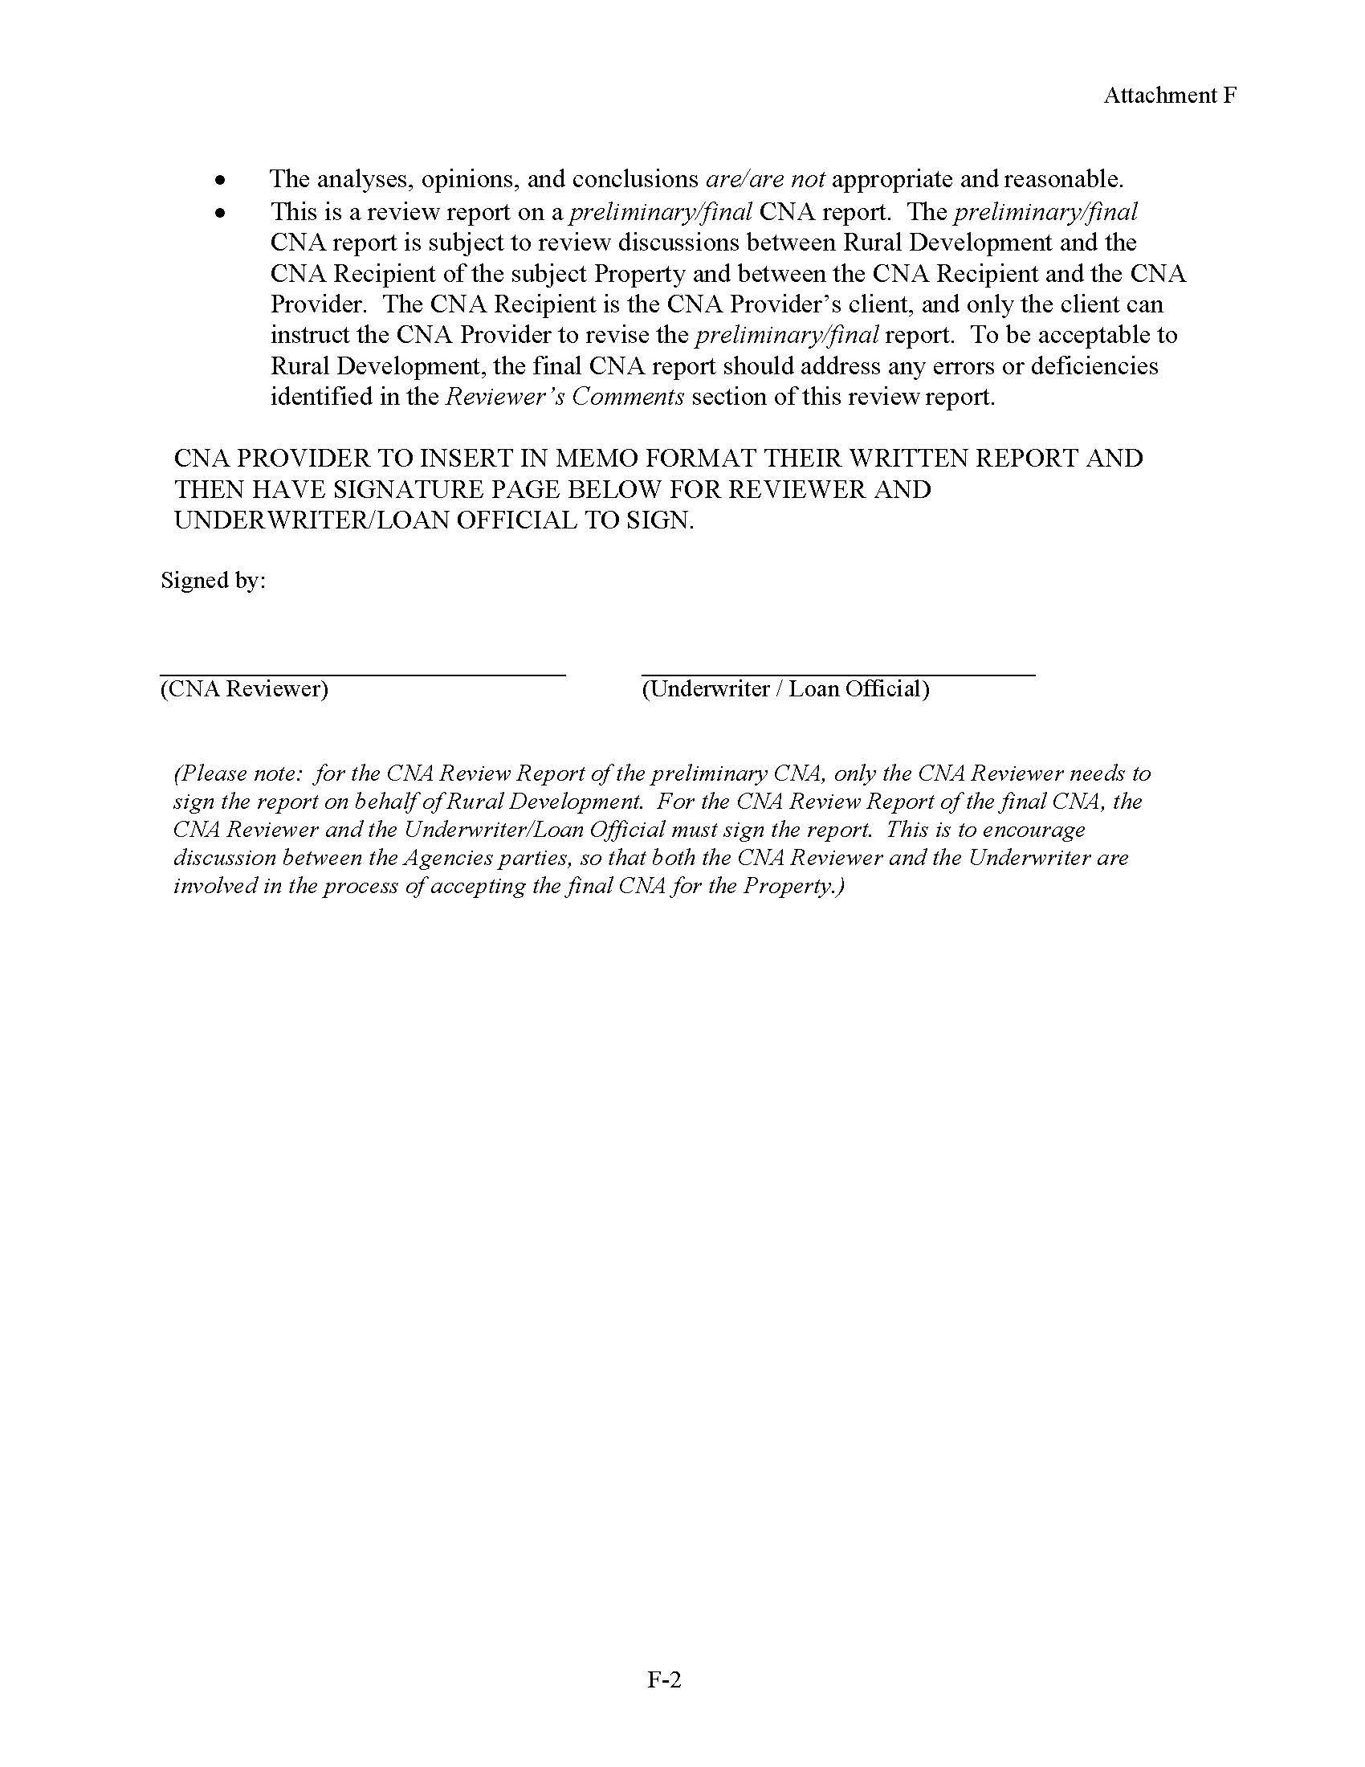

Slide 27
Questions?

Slide 28
PLEASE TAKE OUR SURVEY
Notes:
https://forms.office.com/Pages/ResponsePage.aspx?id=1xT81HkgREaLYJVvZKZM9B3Kb452-ZtChQoWdJFeJqJUMEQzMU1BSk01UTFQTUw5VVlPN0lBS1lMVCQlQCN0PWcu

