Slide 1
Promoting Native Homeownership
[Insert your organization’s logo]
Notes:
A PowerPoint template for introducing strategies to promote homeownership opportunities to your tribal leadership.

Slide 2
A Presentation to Tribal Leaders
Promoting Homeownership in Our Community
Notes:
Tips for using this template:
Replace the photos or graphics with images from your community.
Feel free to add text to reflect the circumstances relevant to your tribal leaders.
Each time you deliver the presentation, debrief with your team and make adjustments to your presentation, as appropriate.

Slide 3
Overview
What is homeownership?
Why homeownership?
Homeownership is possible
Homebuyer success stories
A call to action for tribal leaders

Slide 4
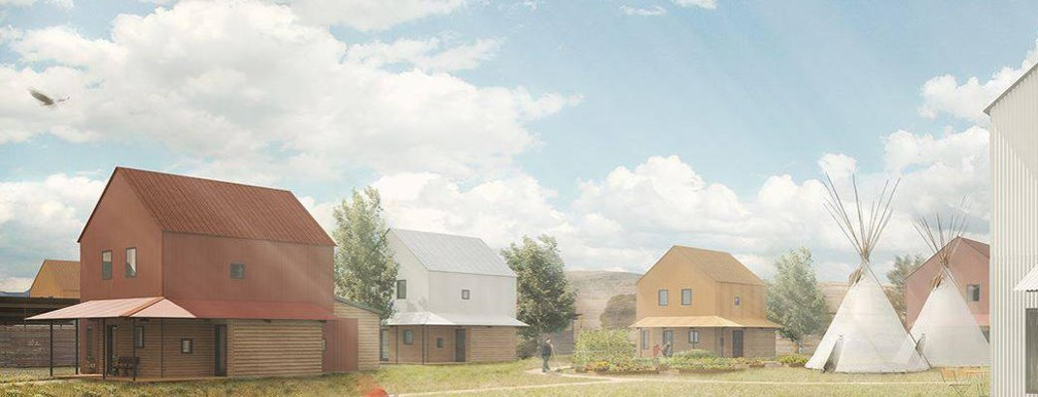
What is homeownership?
When you think of “home,” what feelings come to mind?
Notes:
Ask your tribal leaders to participate in the exercise from Module 1 of the Enhancing and Implementing Homeownership Programs in Native Communities curriculum. https://nativehomeownership.enterprisecommunity.org/course-overview
Present the question – When you think of “home,” what feelings come to mind?
Ask them to write, draw or share their feelings verbally. Examples may include safety, shelter, comfort, warmth, etc.
Encourage them to think of homeownership as a way to bring these feelings to more tribal citizens.

Slide 5
What is homeownership?
Low-income rental units
Mutual Help
Homeownership
Monthly rent based on income
No incentive to increase income
Being phased out
Monthly payments based on ability to qualify
Long waiting list
Financed with mortgage loan
Title conveyance issues
Builds assets to pass on to future generations
Hard to transition from being a tenant to a homeowner because of reliance on housing authority
Notes:
Modify this slide to show the types of housing available in your community by editing the “smart art” graphic.
1) On the left side of the slide, click on the image and then look for the arrow in the white box that appears on the left side.
2) Click on the arrow to open the text box. Replace and describe “low-income rental units” and “Mutual Help units” with the common types of housing in your community.
3) Describe how these options differ from homeownership. Stress that homeownership involves a mortgage loan that uses the land or a leasehold interest in the land (if on trust land) as collateral. Also, explain that homeownership provides the opportunity for families to build assets to pass on to future generations, which doesn’t happen with rental units. Rental tenants pay someone else rent and never own the unit, but when a homeowner pays a mortgage, they own the unit and build equity (money) in their home.

Slide 6
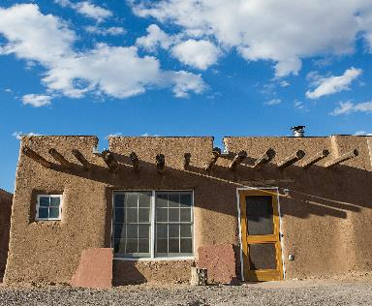
Why homeownership?
Furthers Native tradition of providing shelter
Increases housing stock
Strengthens sovereignty
Stimulates tribal economies
Promotes family stability and self-sufficiency
Leverages scarce housing resources
Notes:
Furthers Native tradition of providing shelter – traditionally, tribes provided shelter for our people [discuss traditional housing in your community]
Increases housing stock – provides a financing mechanism to build more units & provides the opportunity for Tribal members to return home who are living in other cities or urban areas due to the lack of housing available.
Strengthens sovereignty –tribal governments enact their own mortgage ordinance to govern mortgage lending in their jurisdictions
Stimulates tribal economies – when a tribal citizen builds a home, it’s like throwing a stone in the water, there is a ripple affect. Also, provides a way to house workforce.
Promotes family stability and self-sufficiency – families who are homeowners are more stable and accumulate equity
Leverages scarce housing resources – with more families providing their own shelter, the tribe has fewer people to house, which reduces overcrowded situations with multiple generations in one home

Slide 7
Concerns about homeownership
Affordability
Credit issues
Availability of housing stock
Protecting trust land
Notes:
We recognize that there have typically been many perceived barriers to homeownership in Native communities. We’ve listed some on this slide. And you may have other concerns. We are going to address each of these.

Slide 8
Homeownership is affordable
What can a $15/hour employee afford?
Annual salary = $31,000
Home price = $169, 000
Down payment (3%) = $5070
Monthly payments with interest rate of 4% = $700
This is affordable!
Notes:
Customize the examples on this slide to your community.

Slide 9
Homeownership is affordable
How many people might qualify to buy a home in our community?
[Estimate how many families in our community earn $31,000/year or more]
Notes:
Customize the examples on this slide to your community.

Slide 10
Homeownership is affordable
What does this mean for our local economy?
If all the new homeowners in our community bought a gallon of milk at the local grocery store instead of off reservation, that’s a huge boost to our local economy.
Notes:
Customize the examples on this slide to your community.
* In our reservation economies the dollar circulates once before it leaves for an off-reservation community where that same dollar will circulate 7 times before it leaves that off-reservation economy.

Slide 11
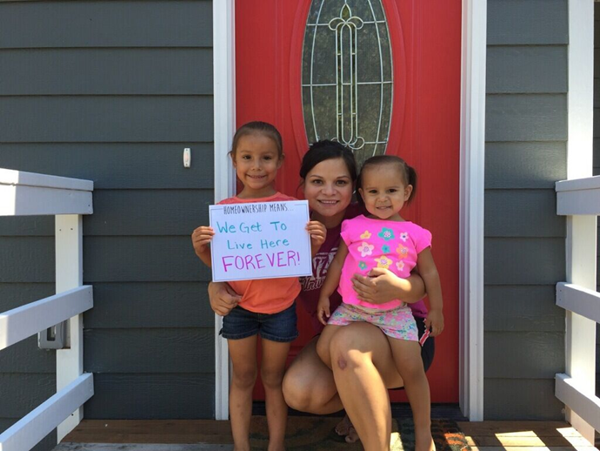
Our people can qualify for mortgages
The demand and potential for homeownership in Native communities is real!
Notes:
Tribal Members want to own their own homes and there is a growing number who can afford a mortgage
75% of reservation residents report a strong desire to own their own home (2017 HUD study).
Tribal economies and the financial capacity of tribal members are growing.
Rising middle class and need of homes for working professionals, especially for commuters form border towns. On some reservations, over 70% of the workforce commutes.
Over 40% of reservation households have income over the U.S median.
Credit risk scores are on the rise (p. 58 in TLHH). Over 50% of borrowers living on reservations already have prime (above average) credit scores.
Give specific examples of the types of clients you are working with in your community.

Slide 12
We can increase housing stock
Local contractors
Housing Authority
Infrastructure partners
Notes:
We have identified partners in our community to help to overcome the lack of housing and related infrastructure like roads, sewer and utilities. Share specifics about what you are doing to encourage residential construction in your community, e.g. Identify appraisers, inspectors, contractors, insurance providers, etc.

Slide 13
We can protect trust land
We can use leasehold mortgage transactions to protect our land
Notes:
Tribal leaders can enact their own laws to govern the mortgage process. They can also use the HEARTH Act to take over their own residential leasing process from the BIA, if they so chose.

Slide 14
Homebuyer Stories
Notes:
Insert slides to showcase homeowners from your community. Includes pictures and personal stories.
Consider showing a video of homeowner testimonials from this website: http://nativehomeownership.com/

Slide 15
A Call to Action for Tribal Leaders
Create legal infrastructure
Enact mortgage and foreclosure ordinances
Streamline the land management process to support leasehold mortgages on trust land
Define Tribe’s role with foreclosure
Promote early intervention to avoid foreclosure
Offer risk mitigation strategies
Purchase foreclosed units
Notes:
List specific things you want your tribal leaders to do to support your efforts to promote homeownership.

Slide 16
A Call to Action for Tribal Leaders
Make homeownership more accessible
Prioritize financial education opportunities
Identify down payment assistance funding
Offer homebuyer education
Convene a homeownership team
Assign staff to coordinate homeownership efforts
Build staff capacity with training and technical assistance

Slide 17
A Call to Action for Tribal Leaders
Dedicate resources
Include homeownership goals in Indian Housing Plan
Bring lending programs to community
Explore federal loan products (HUD, USDA, VA)
Consider conventional lending options
Attract lenders to your community
Prioritize infrastructure development for housing
Identify land to develop homeownership opportunities

Slide 18
A Call to Action for Tribal Leaders
Other Items
[insert something unique to your community]
Promote self-sufficiency
Reduce your Tenant Accounts Receivable (TARS)
Create an expectation of repayment
Charge market rent in rental units

Slide 19
Homeownership in our community
[insert photos of homeowners in your community]

Slide 20
Homeownership in our community
[insert photos of homeowners in your community]

Slide 21
Homeownership in our community
[insert photos of homeowners in your community]

